Slide 1
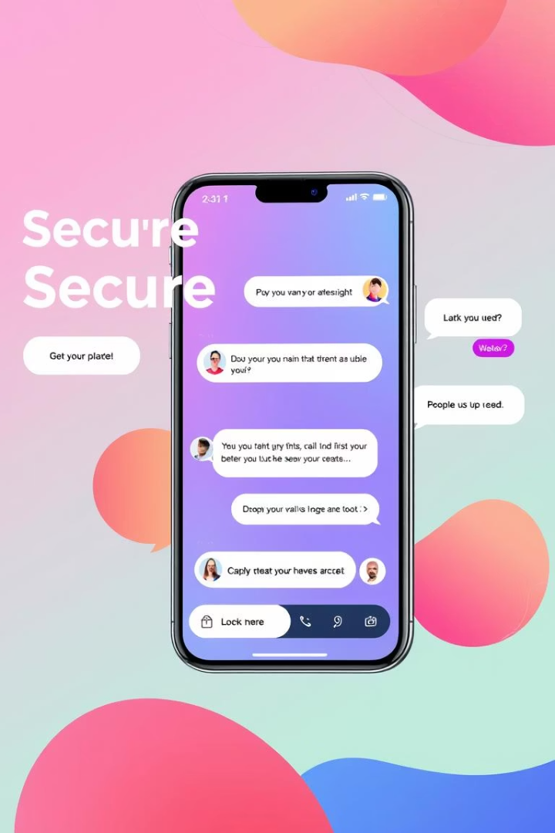
Welcome to QuantaTalk
Your cutting-edge web messaging app for secure, seamless communication
Powered by a modern tech stack ensuring scalability and robust security
Designed for an intuitive user experience with real-time messaging and cross-platform accessibility
YK
by YASH KUMAR

Slide 2

Frontend Layer: React.js, TypeScript, and TailwindCSS for Web App
React.js
TypeScript
Component-based architecture for dynamic UI
Enhanced code quality and maintainability
TailwindCSS
Rapid UI development with utility-first approach

Slide 3




Frontend Architecture: Communication with Firebase and Google APIs
HTTP/SDK
Asynchronous Data Fetching
Connecting frontend with backend services
Real-time updates for instant messaging
Google APIs Integration
Smooth connection to Google ecosystem

Slide 4
Application Layer: Firebase JavaScript SDK
Authentication
Data Read/Write
File Uploads
Secure user login with Firebase Auth
Firestore for real-time database operations
Firebase Storage for media sharing

Slide 5




Application Logic: Routing, State, and Google OAuth
Routing
React Router for intuitive navigation
State Management
Redux and Context API for smooth data flow
Google OAuth
Seamless user login with Google accounts

Slide 6
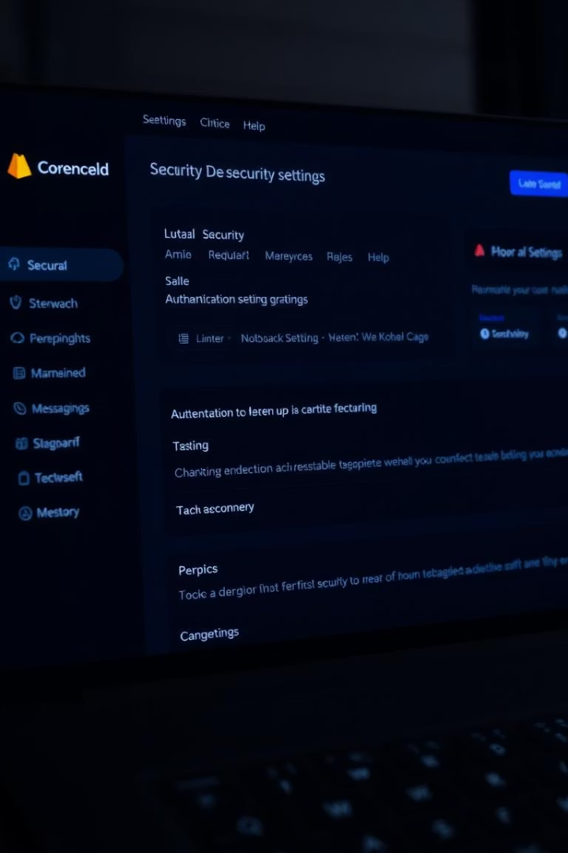


Backend Layer: Firebase Authentication & Google People API
Firebase Authentication
Google People API
Robust user identity management
Contacts integration and profile enhancement

Slide 7



Backend Security: Firestore and Storage Rules
Firestore Rules
Fine-grained access control to protect data
Storage Rules
Secure file uploads and downloads
GCP Hosting
Reliable cloud infrastructure by Google

Slide 8




QuantaTalk: Scalable and Secure Messaging
GCP Scalability
End-to-End Encryption
Handles growth seamlessly with cloud power
Ensuring privacy and secure communication
Transforming Communication
Next-generation messaging experience

Slide 9




Hosting Using Google Cloud Platform
Google Cloud Platform ensures reliable, scalable hosting for QuantaTalk.
It offers robust infrastructure and seamless integration with Firebase services.
Scalability
Global Reach
Automatically handles increased traffic without downtime.
Data centers worldwide for fast and consistent user experiences.
Security
Seamless Integration
Advanced security protocols protect data and user privacy.
Connects smoothly with Firebase Authentication and Storage.

Slide 10
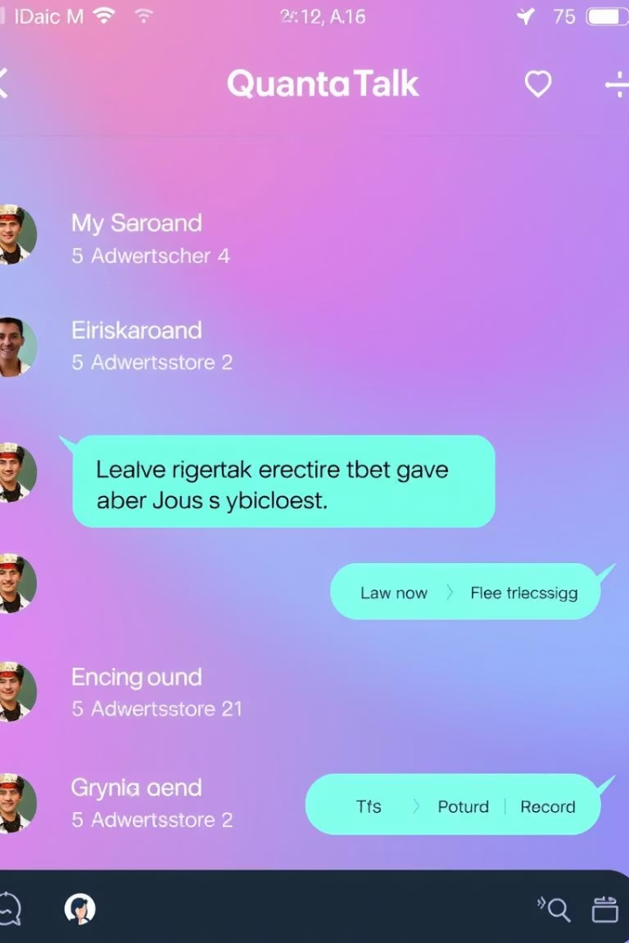
App Preview: QuantaTalk in Action
Explore user-friendly interface and seamless messaging flow
Fast, secure, and intuitive communication experience

Slide 11
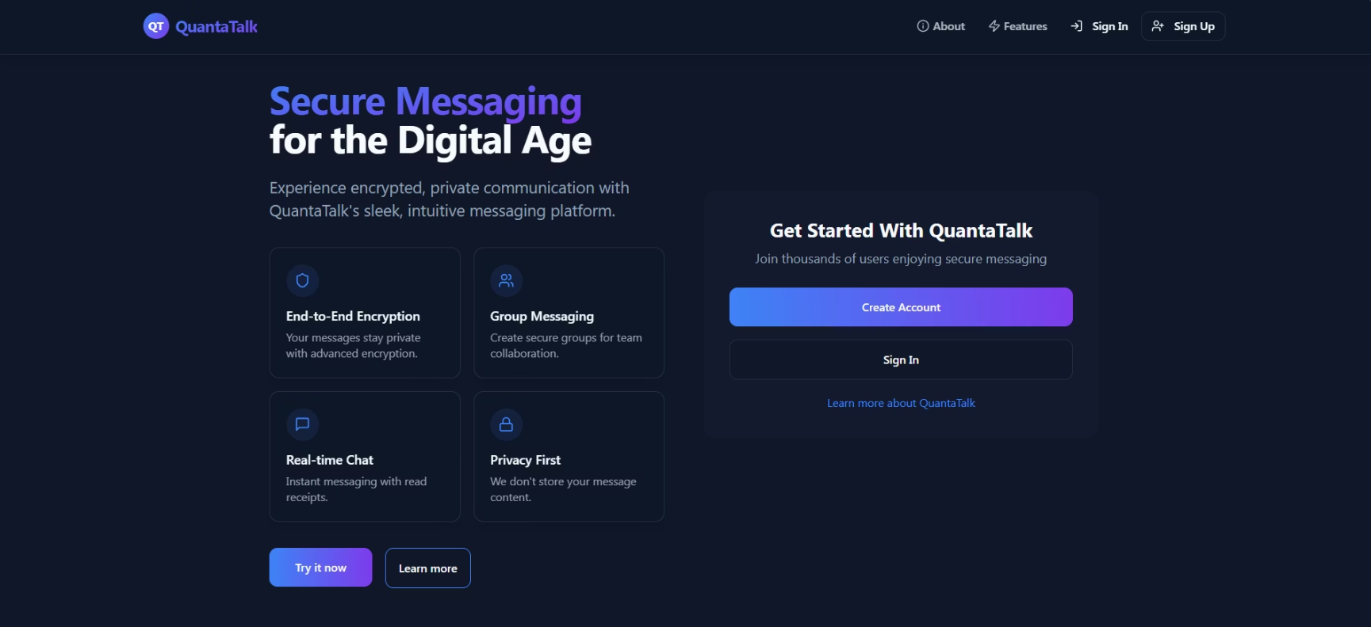
HOME PAGE

Slide 12
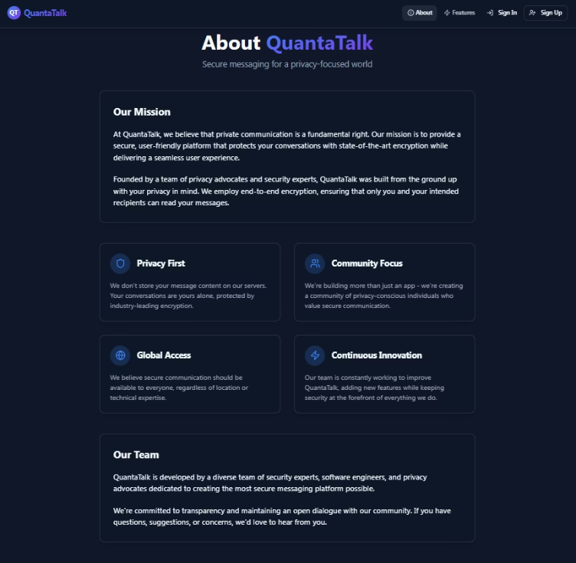
ABOUT PAGE
The About Page provides an overview of QuantaTalk’s mission, vision, and key features. It highlights the core values that drive our development and showcases the team behind the platform.

Slide 13
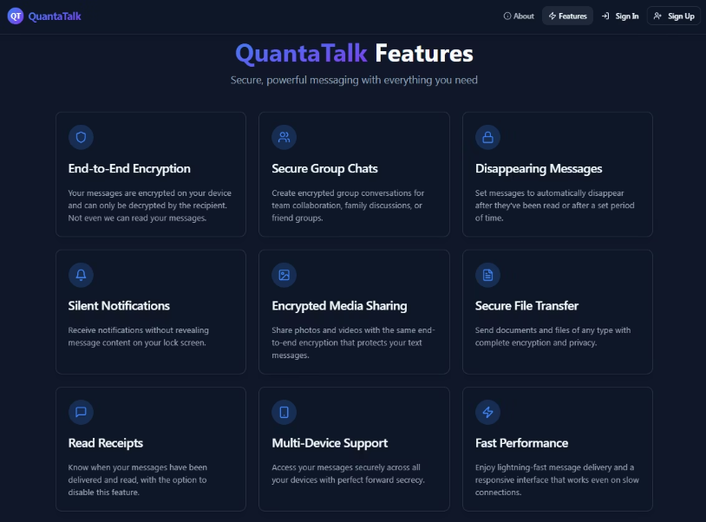
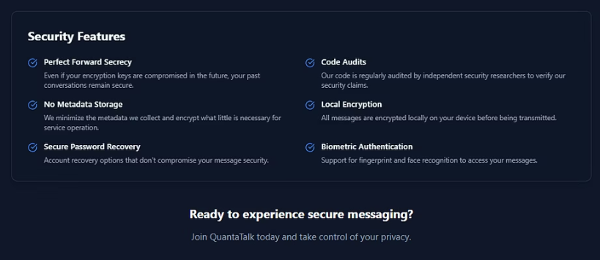
FEATURES PAGE
The Features Page delves into the specific functionalities offered by QuantaTalk, such as real-time messaging, video calls, and file sharing capabilities. Users can explore these features in detail to understand how QuantaTalk can enhance their communication experience.

Slide 14
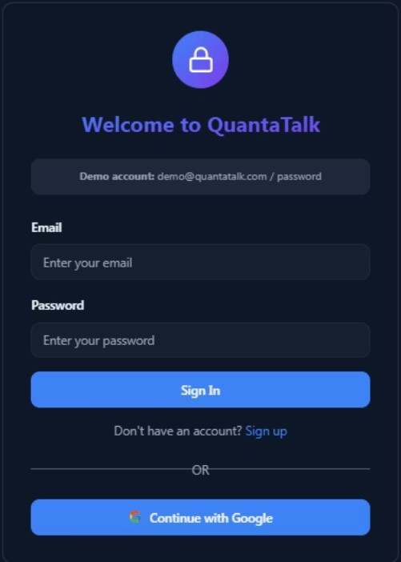
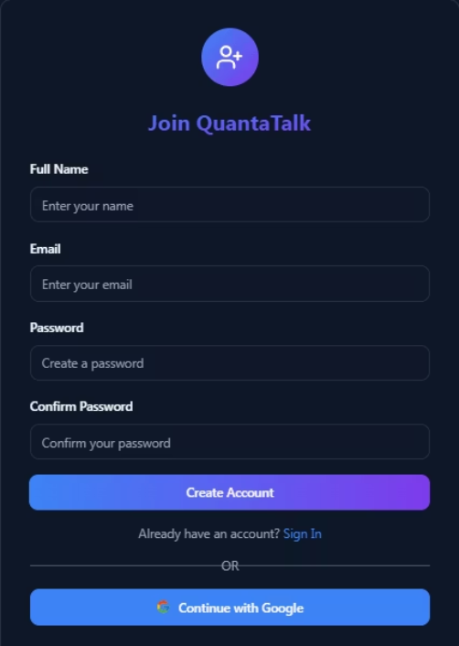
SIGN-IN/SIGN-UP PAGES

Slide 15
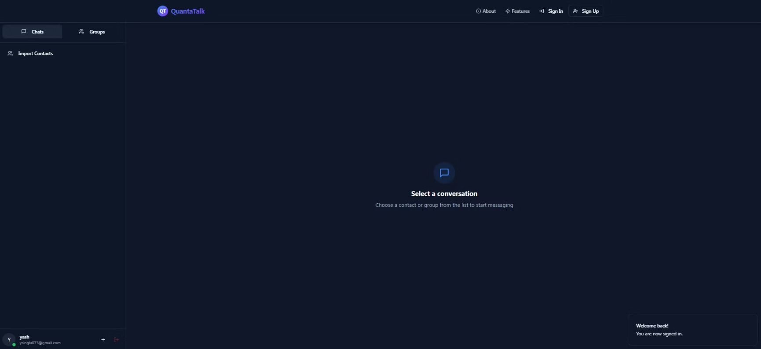
CHAT PAGE

Slide 16
Thank You!
We appreciate your time and interest in QuantaTalk.
Feel free to reach out with any questions or feedback.

